Slide 1
Model representation
Linear regression with one variable

Slide 2
Housing Prices
(Portland, OR)
220
Price
(in 1000s of dollars)
1250
Size (feet²)
Supervised Learning
Given the “right answer” for each example in the data.
Regression Problem
Predict real-valued output
Classification : Discrete-valued output

Slide 3
Training set of
housing prices
(Portland, OR)
Size in feet² (x) | Price ($) in 1000's (y)
2104 | 460
1416 | 232
1534 | 315
852 | 178
… | …
m
Notation:
m = Number of training examples
x’s = “input” variable / features
y’s = “output” variable / “target” variable
x⁽¹⁾ = 2104
x⁽²⁾ = 1416
y⁽¹⁾ = 460
(x, y) – one training example
(x^{(i)}, y^{(i)}) – ith trainingg example

Slide 4
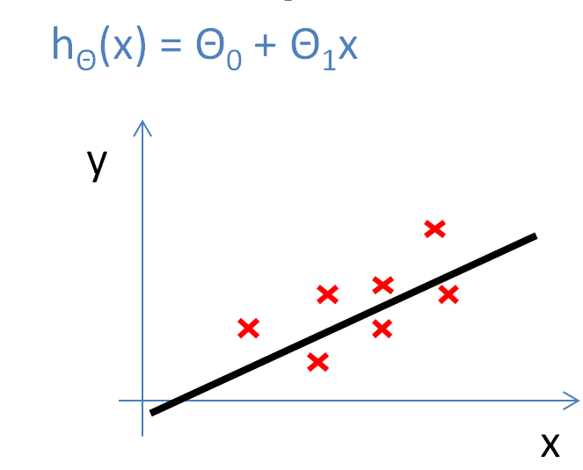
Training Set
How do we represent h ?
Learning Algorithm
Size of house
h
Estimated price
x
hypothesis
Estimated
value
Linear regression with one variable.
Univariate linear regression.
h maps from x’s to y’s
One variable

Slide 5
Cost function
Linear regression with one variable

Slide 6
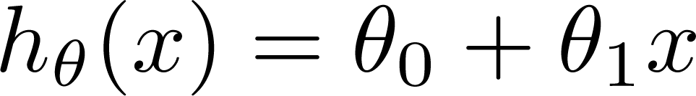

Training Set
Size in feet² (x) | Price ($) in 1000's (y)
2104 | 460
1416 | 232
1534 | 315
852 | 178
… | …
Hypothesis:
‘s: Parameters
How to choose ‘s ?

Slide 7
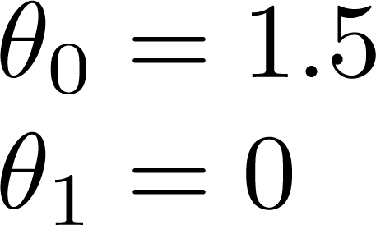
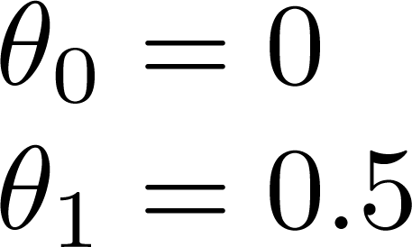
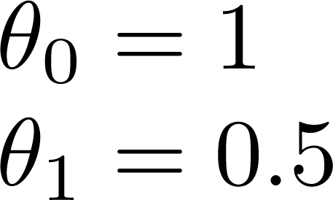
h(x) = 1.5 + 0·x
h(x) = 0.5·x
h(x) = 1 + 0.5·x

Slide 8
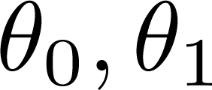


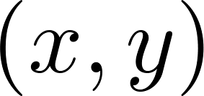



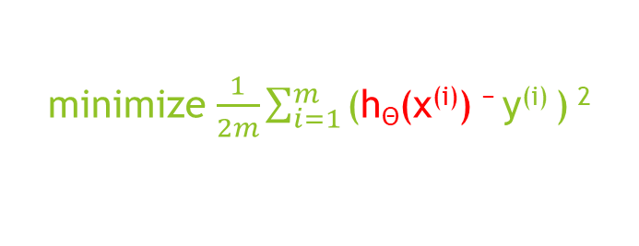
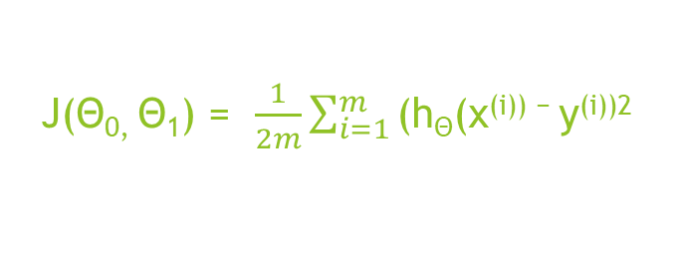


(x^{(i)}, y^{(i)})
y
minimize $\frac{1}{2m}\sum_{i=1}^{m}{\text{(}\text{h}\text{Θ}\text{(}\text{x}\text{(}\text{i}\text{)) − }\text{y}\text{(}\text{i}\text{) }}$) $\text{2}$
$$\text{Θ}\text{0, }\text{Θ}\text{1}$$
$$\text{Θ}\text{0}$$
$$\text{Θ}\text{1}$$
Where h(x) = $\text{Θ}\text{0}$+ $\text{Θ}\text{1}\text{x}\text{(}\text{i}\text{)}$
x
J($\text{Θ}\text{0, }\text{Θ}\text{1}$) = $\frac{1}{2m}\sum_{i=1}^{m}{\text{(}\text{h}\text{Θ}\text{(}\text{x}\text{(}\text{i}\text{)) − }\text{y}\text{(}\text{i}\text{))2 }}$
Idea: Choose so that is close to for our training examples
Minimize J($\text{Θ}\text{0, }\text{Θ}\text{1}$) : Cost Function or
$$\text{Θ}\text{0}$$
$$\text{Θ}\text{1}$$
Squared error function

Slide 9
Cost function intuition I
Linear regression with one variable

Slide 10
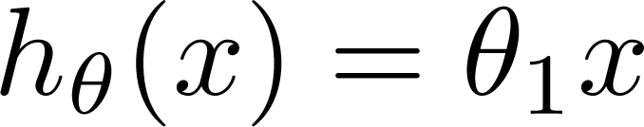

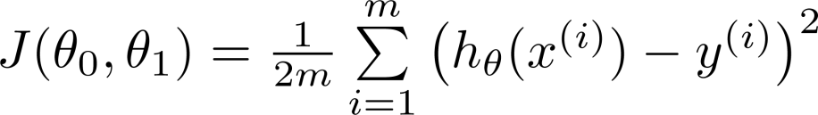
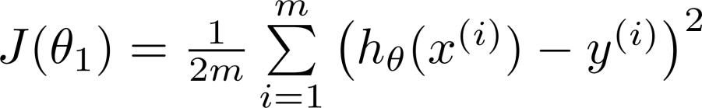
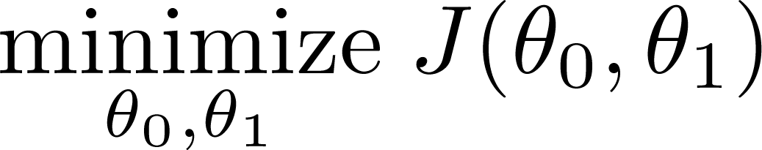
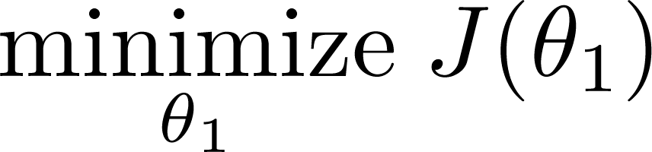

Simplified
Hypothesis:
Parameters:
h(x)
$\text{Θ}\text{0}$ = 0
h(x)
Cost Function:
Goal:

Slide 11






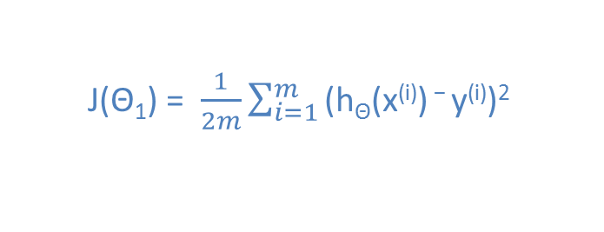


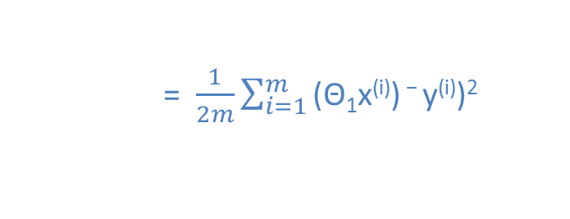
(for fixed , this is a function of x)
(function of the parameter )
y
x
J($\text{Θ}\text{1}$) = $\frac{1}{2m}\sum_{i=1}^{m}{\text{(}\text{h}\text{Θ}\text{(}\text{x}\text{(}\text{i}\text{)) − }\text{y}\text{(}\text{i}\text{))2 }}$
= $\frac{1}{2m}\sum_{i=1}^{m}{\text{(}\text{Θ}\text{1}\text{x}\text{(}\text{i}\text{)) − }\text{y}\text{(}\text{i}\text{))2 }}$
$$J\left(1\right)=0$$
= $\frac{1}{2m}\left(02+02+02\right)$

Slide 12

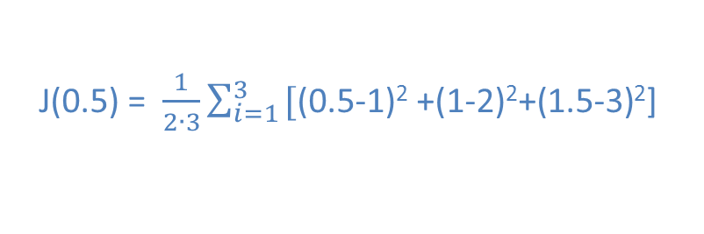



(for fixed , this is a function of x)
(function of the parameter )
y
$$\text{y}\text{(}\text{i}\text{)}$$
$$\text{h}\text{Θ}\text{(}\text{x}\text{(}\text{i}\text{))}$$
x
J($\text{0.5}$) = $\frac{1}{2∙3}\sum_{i=1}^{3}{\text{[}\text{(0.5−1)}\text{2} \text{+}\text{(}\text{1−2}\text{)}\text{2}\text{+(1}\text{.5−3}\text{)}\text{2}\text{]} }$
= $\frac{1}{6}∙$(3.5) = 0.58

Slide 13

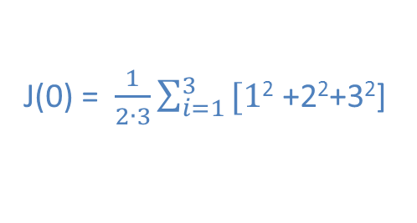

(for fixed , this is a function of x)
(function of the parameter )
y
x
J($\text{0}$) = $\frac{1}{2∙3}\sum_{i=1}^{3}{\text{[1}\text{2} \text{+2}\text{2}\text{+}\text{3}\text{2}\text{]} }$
= $\frac{1}{6}∙14$ = 2.3

Slide 14
Cost function intuition II
Linear regression with one variable

Slide 15
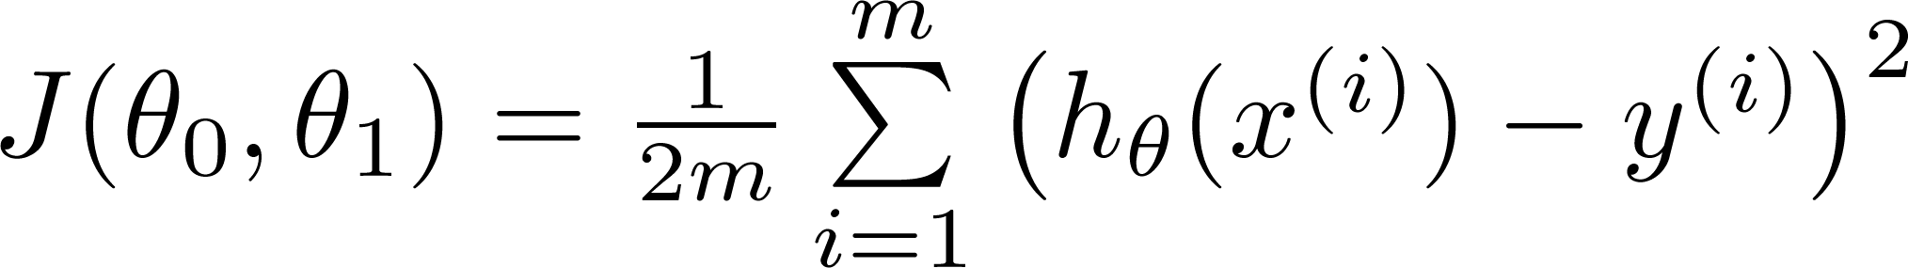
Hypothesis:
Parameters:
Cost Function:
Goal:

Slide 16
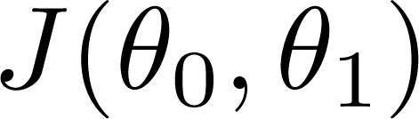


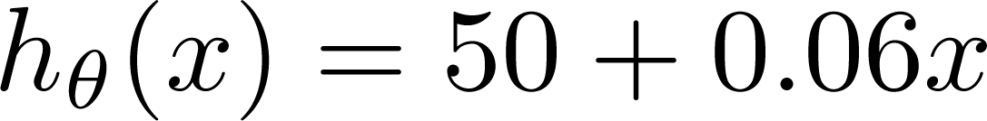


(for fixed , this is a function of x)
(function of the parameters )
Price ($)
in 1000’s
$\text{Θ}\text{0}$ = 50
$\text{Θ}\text{1}$ = 0.06
Size in feet² (x)

Slide 17
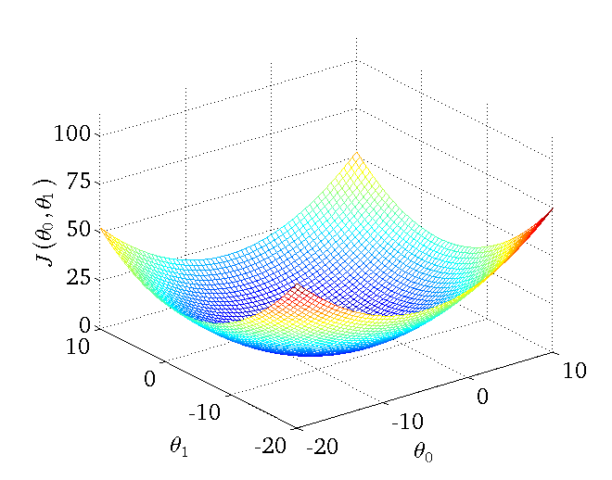
Contour plots

Slide 18
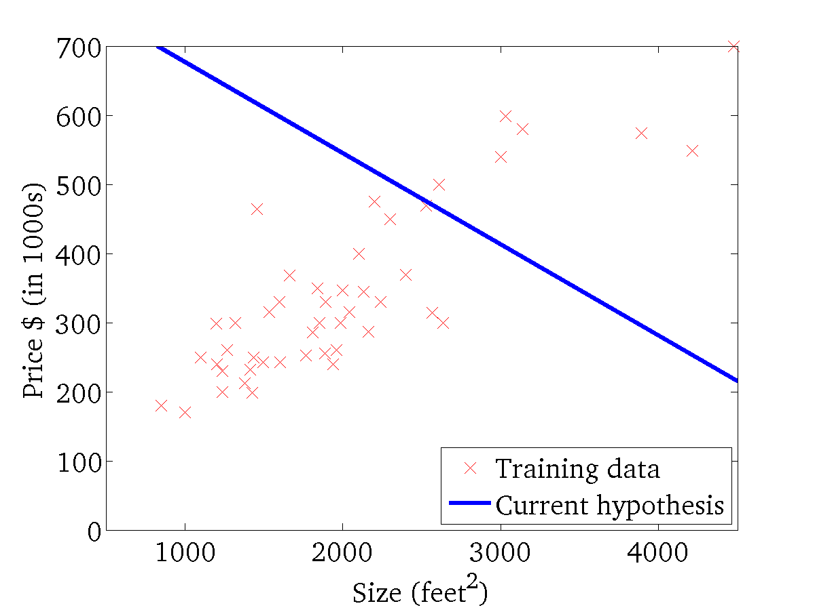
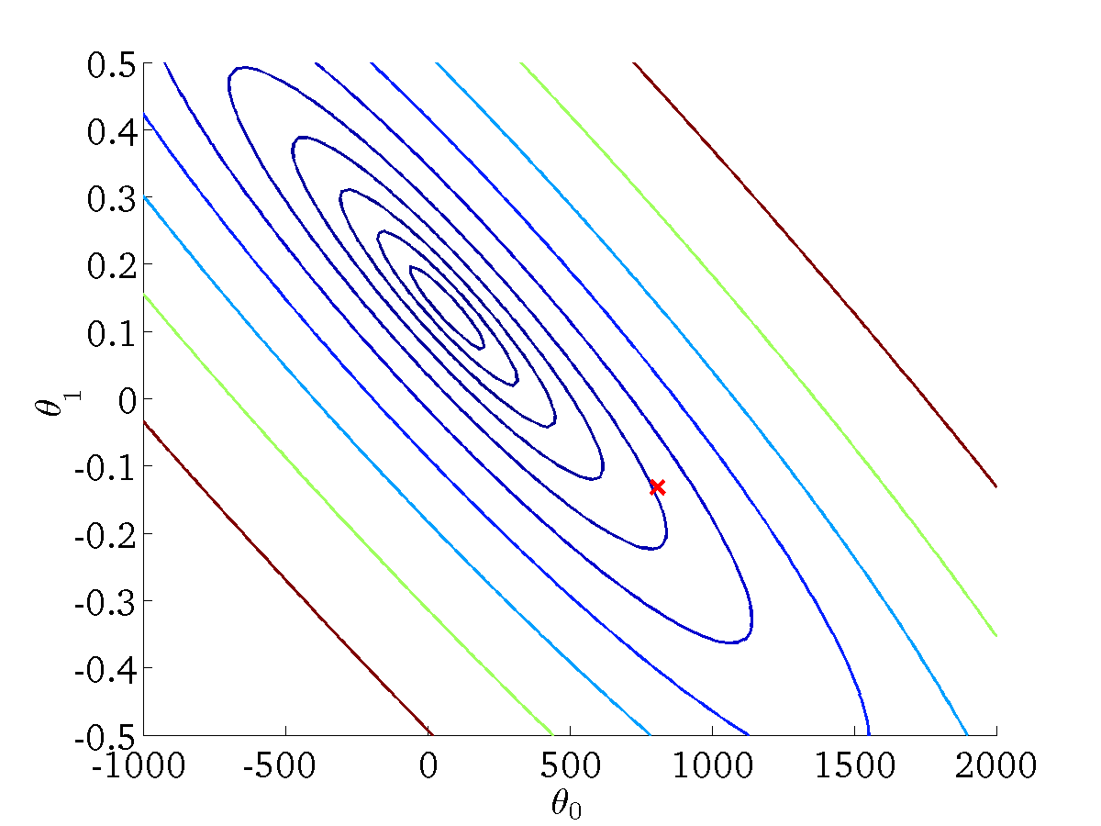
(for fixed , this is a function of x)
(function of the parameters )

Slide 19
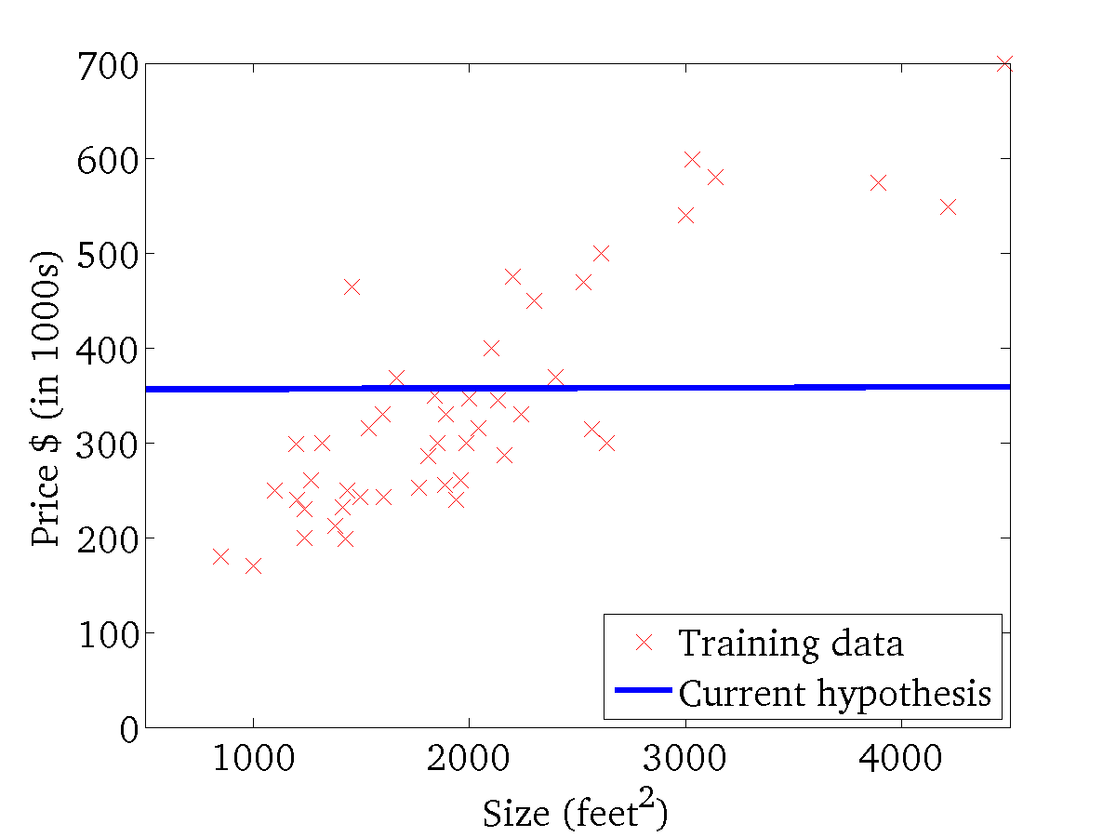
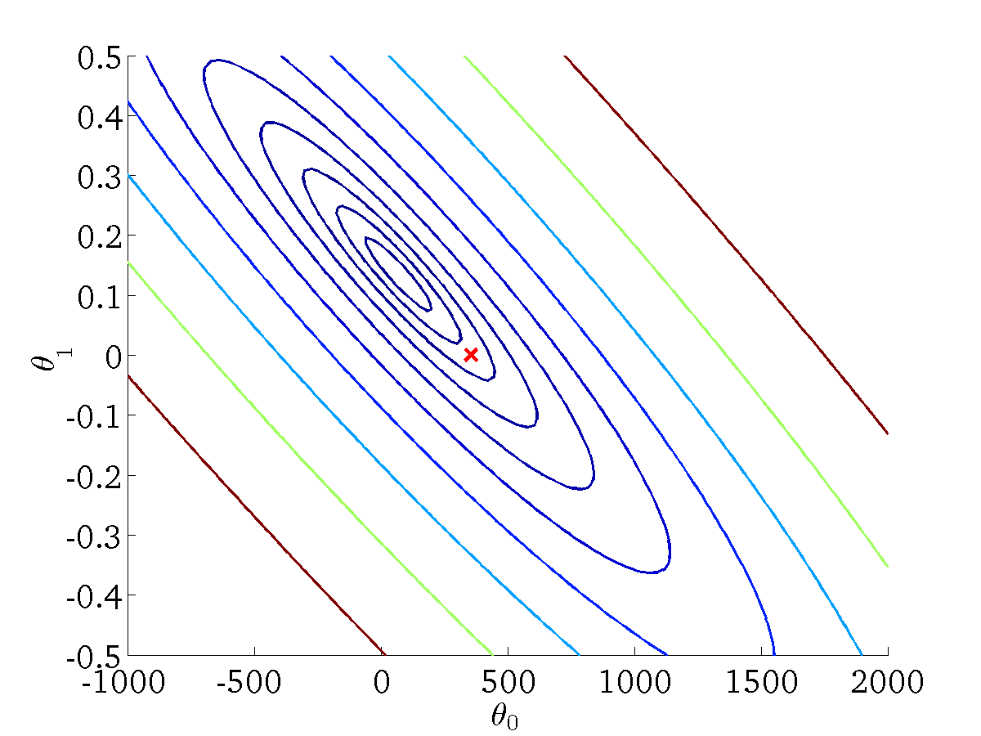


(for fixed , this is a function of x)
(function of the parameters )
h(x) = 360 + 0·x
$\text{Θ}\text{0}$ = 360
$\text{Θ}\text{1}$ = 0

Slide 20
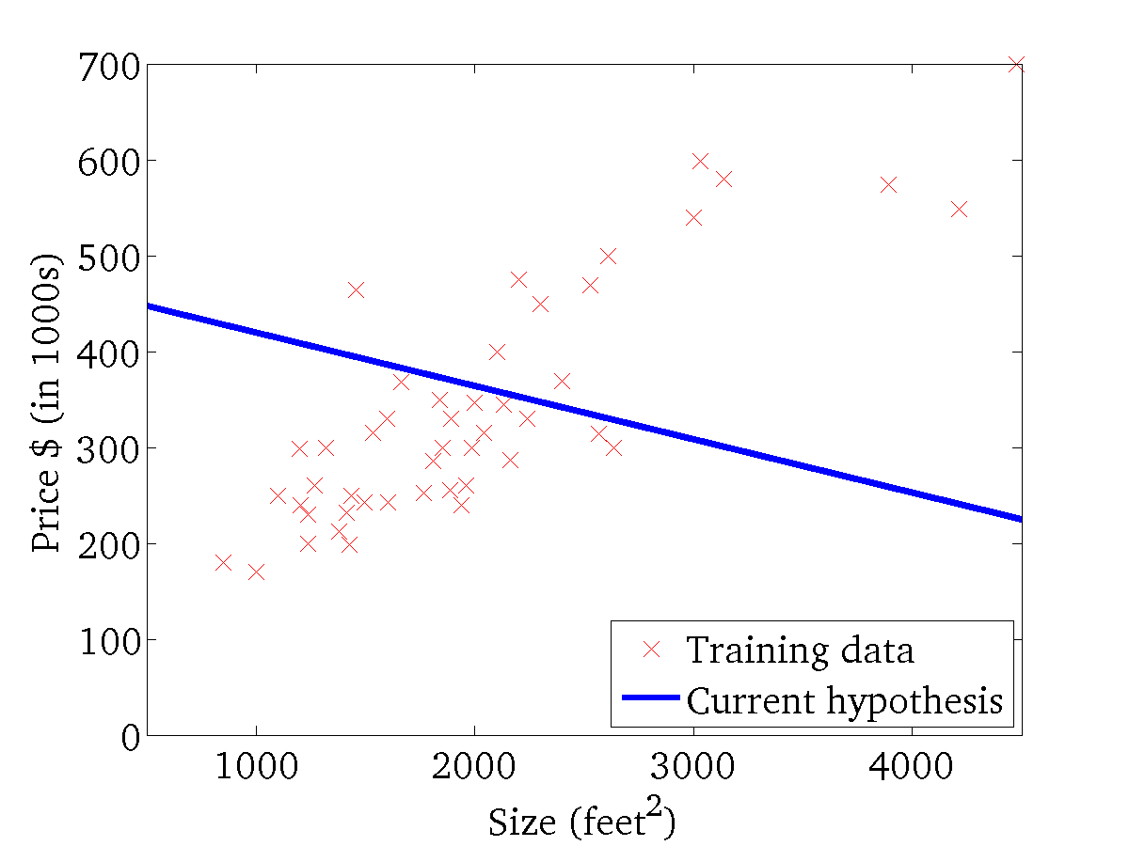

(for fixed , this is a function of x)
(function of the parameters )

Slide 21
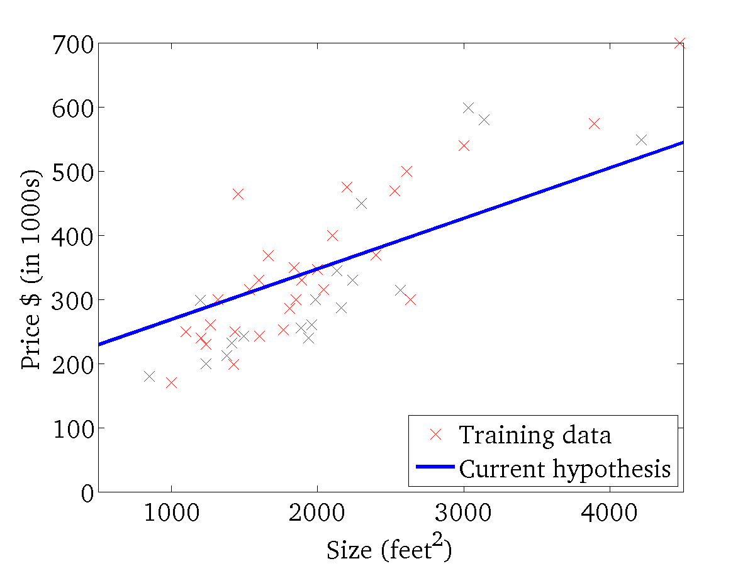
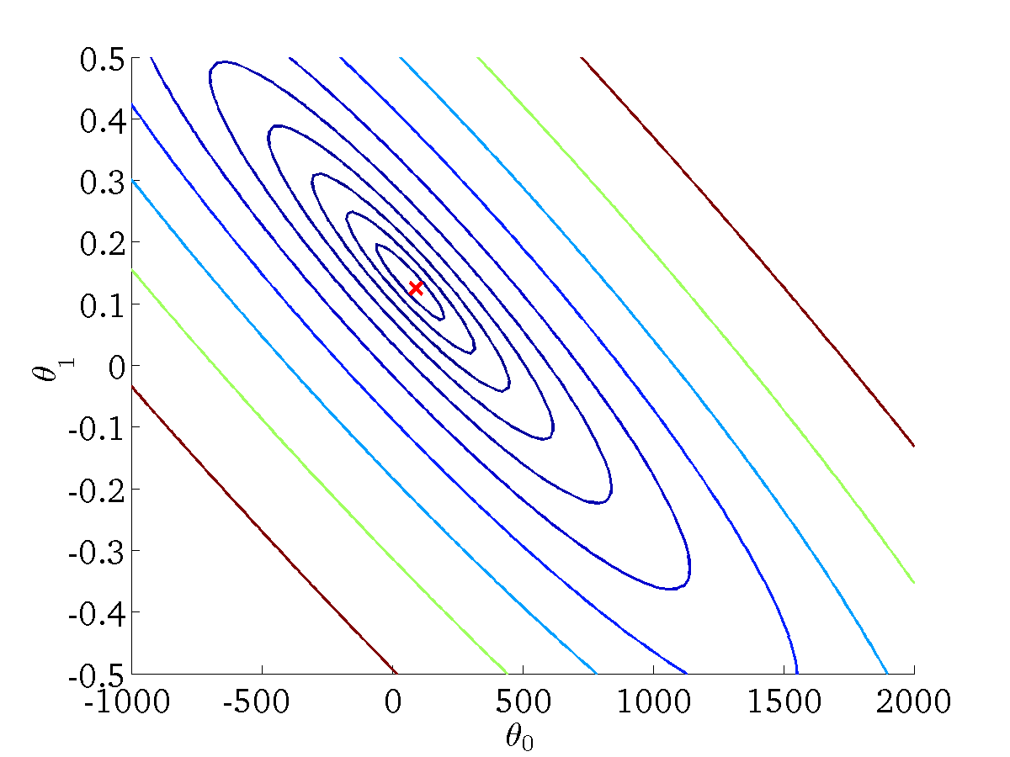
(for fixed , this is a function of x)
(function of the parameters )

Slide 22
Gradient descent
Linear regression with one variable

Slide 23
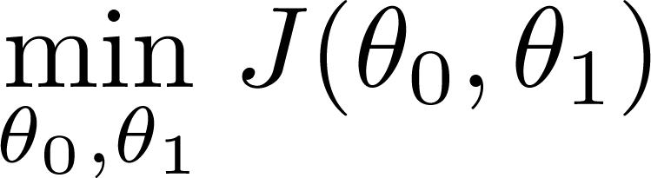
Have some function
Want
Outline:
Start with some
Keep changing to reduce until we hopefully end up at a minimum

Slide 24
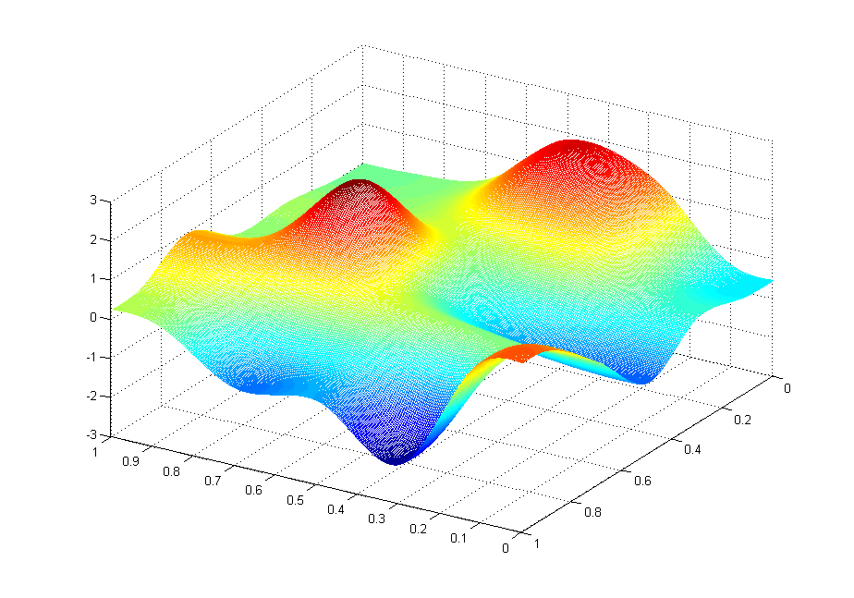
J(θ₀,θ₁)
θ₁
θ₀

Slide 25
J(θ₀,θ₁)
θ₁
θ₀

